Slide 1

Medical Inventory Management Project – Agile Scrum Framework
A Journey of Continuous Improvement
Presented by: Pratik kale

Slide 2
Content
Introduction
Project Overview & Objectives
Our Team
Roles and Responsibilities
Agile Manifesto
Why Agile & Scrum Framework
Agile Framework Explanation
Key Ceremonies & Benefits
Project Description
Medical Inventory Management System

Slide 3
Sprint Plan
Sprint Structure & Key Milestones
Feature Development
Iterative Development & Improvements
Continuous Feedback & Improvement
Client Collaboration & Enhancements
Future Roadmap
Long-Term Enhancements
Conclusion
Summary & Final Thoughts

Slide 4
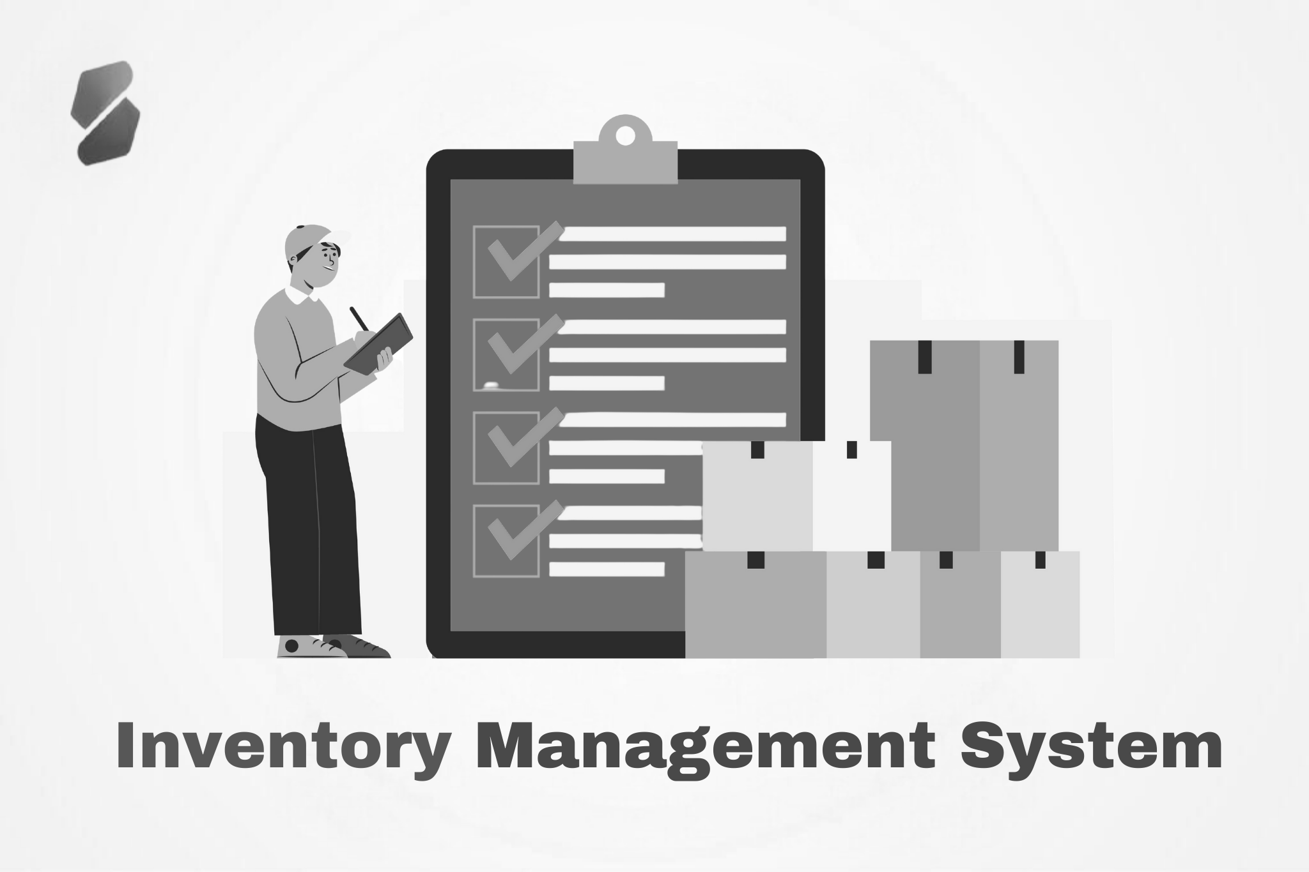
Introduction
Welcome to our presentation on the Medical Inventory Management System developed using the Agile Scrum framework.
In this project, our team aims to create an efficient and scalable solution for managing medical inventory at pharmacies. Through iterative development and continuous feedback, we will ensure a user-friendly, reliable, and adaptable system to meet evolving client needs.

Slide 5



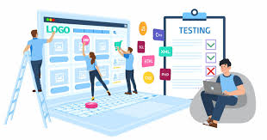


Our Team
Python Developers (2): Build and maintain the application’s code.
Manager / product owner:
Acts as a bridge between the client and the team, ensuring alignment and execution.
Data Analyst: Extracts insights and validates data.
Business Analyst / Scrum Master: Guides the agile process and ensures effective collaboration.
Client (Stakeholder): Provides valuable feedback to shape the project.
Tester: Ensures quality through rigorous testing.

Slide 6
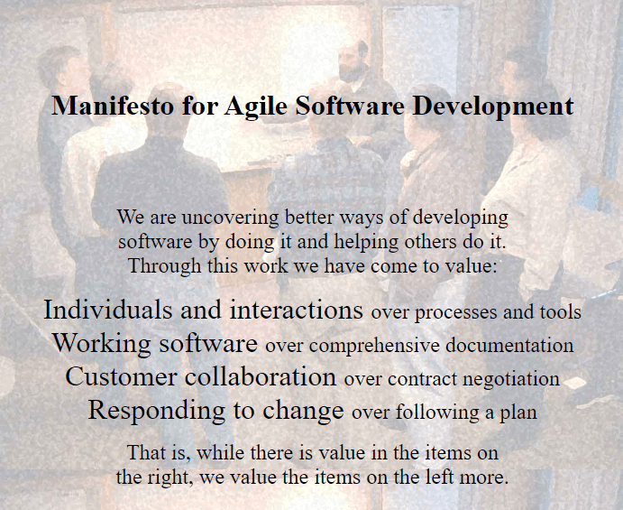
Agile Manifesto
Guiding Principles for Agile Development
The Agile Manifesto outlines core values and principles for iterative development and customer collaboration in software and project delivery.
Core Values of Agile:
Individuals and interactions over processes and tools
Working software over comprehensive documentation
Customer collaboration over contract negotiation
Responding to change over following a plan
These principles guide teams toward delivering continuous value and adapting to change based on customer feedback.

Slide 7
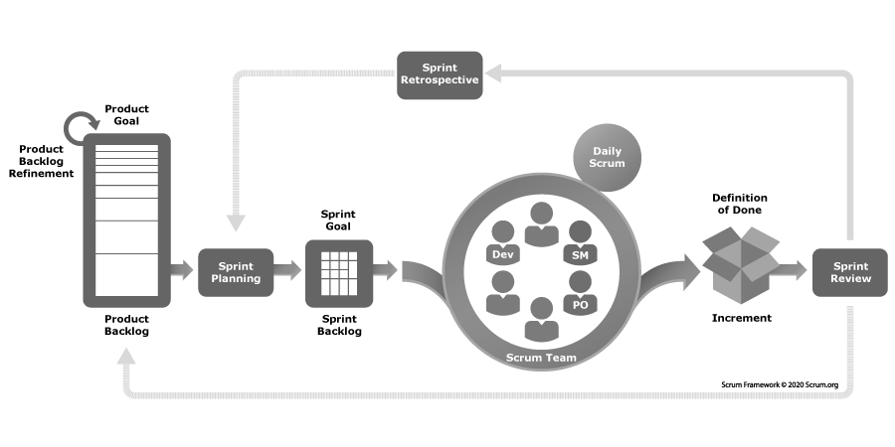
Agile Framework
Scrum Framework:
Organizes work into time-boxed iterations called sprints.
Key ceremonies include Sprint Planning, Daily Stand-ups, Sprint Reviews, and Retrospectives.
Benefits:
Improves transparency, responsiveness, and team collaboration.

Slide 8
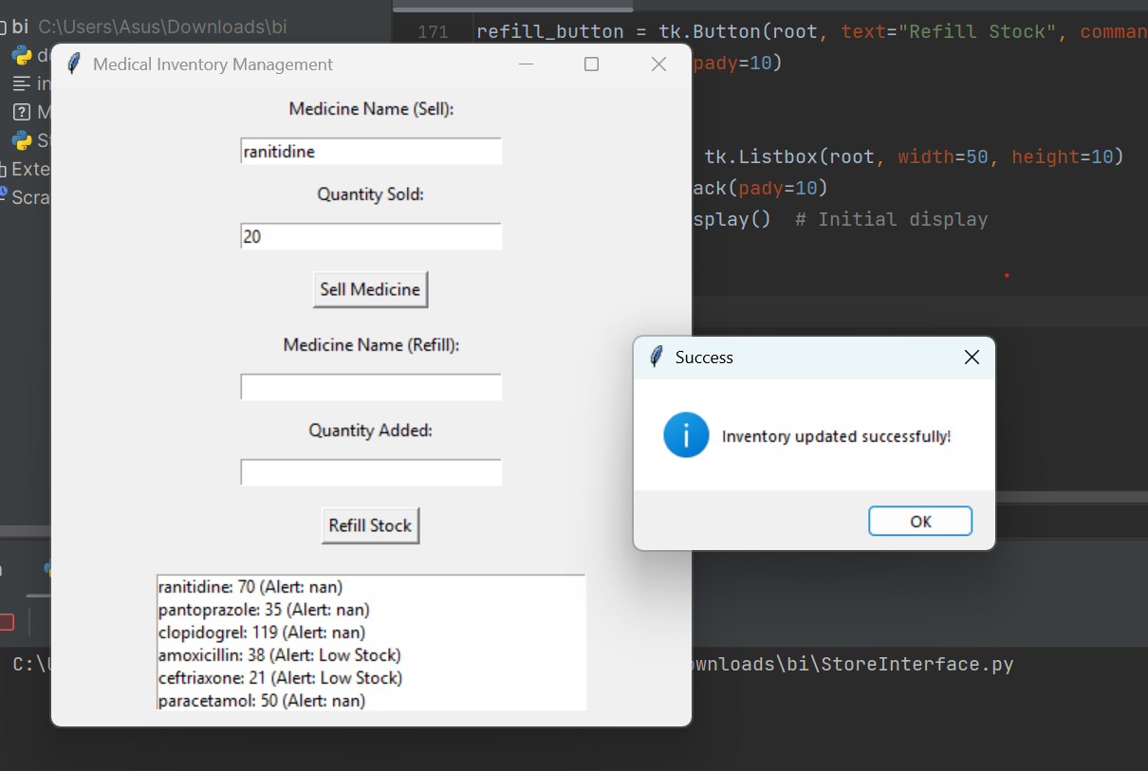
Project Overview
Project Goal:
Streamline pharmacy operations with a GUI-based application integrated with Excel.
Core Features:
Selling medicine, refilling stock, and automatic low stock alerts.
Value Proposition:
Enhanced inventory management leading to better efficiency and reduced errors.

Slide 9
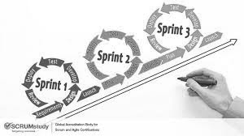
Sprint Overview – Part 1
Sprint Structure:
Each sprint is a 3-week cycle.
Early sprints focus on launching core features (e.g., Sell Medicine, Refill Stock).
Iterative Improvement:
Features are developed, tested, and refined incrementally.
Key Point:
We launch and upgrade the product at every sprint.

Slide 10
Sprint Overview – Part 2
Advanced Features:
Later sprints introduce enhancements like advanced reporting, integration, and UI improvements.
Continuous Adaptation:
Each sprint incorporates client feedback for further refinement.
Key Point:
Our process evolves the product through iterative and continuous improvement.

Slide 11
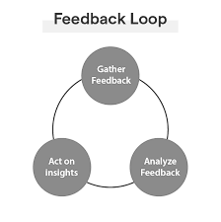
Continuous Feedback & Improvement
Feedback Loop:
Regular sprint reviews capture insights from stakeholders and end users.
Ongoing Adjustments:
Feedback directly influences the next sprint’s priorities.
Commitment:
Continuous improvement ensures our solution remains effective and relevant.

Slide 12
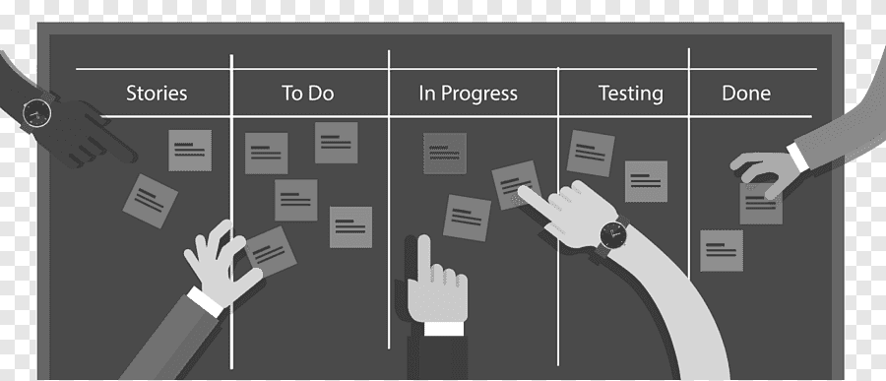
Next Steps
Future Enhancements:
Expansion to advanced analytics, integration with pharmacy systems, and additional features.
Ongoing Sprints:
We will continue to iterate and enhance the product based on new requirements.
Roadmap:
A flexible plan that adapts as customer needs evolve.

Slide 13

Conclusion
Summary:
Our Agile Scrum approach delivers a user-centric, high-quality solution through continuous, iterative development.
Final Thought:
We value collaboration, learning, and feedback to ensure long-term success.

Slide 14
Thank You

